Slide 1

Health Information System
By:Benson Kimani Ngigi
Date: 27/04/2025

Slide 2
Introduction
Introduction
This project involves the development of a basic Health Information System designed for medical professionals, particularly doctors.
The system allows doctors to register clients (patients), create health programs (such as TB, Malaria, HIV programs), and enroll clients into these programs based on their medical needs.
All functionalities are exposed through secure RESTful APIs, built using the Django framework and the Django REST Framework (DRF).
This setup ensures that external systems (like hospital software, mobile apps, etc.) can also connect to the system and retrieve or update client information safely.
The solution emphasizes easy access, data security, and scalability.

Slide 3
Problem Definition
Problem Definition
Healthcare facilities often need a centralized system to manage patients and track their participation in various health programs (e.g., TB, Malaria, HIV care).
Doctors require an efficient solution to:
Create and manage health programs (like TB, HIV, Malaria).
Register clients (patients) and maintain accurate health records.
Enroll clients in one or multiple relevant health programs.
Search and retrieve client records quickly based on client name or ID.
View detailed client profiles, including personal data and their program enrollments.
Expose client profiles securely via APIs, allowing integration with other digital health systems or reporting tools.

Slide 4

Objectives
Objectives
Build a system that allows doctors to:
Create health programs.
Register clients
Enroll clients into programs
View client profiles
Search for clients.
Expose client profiles via secure APIs for integration.

Slide 5
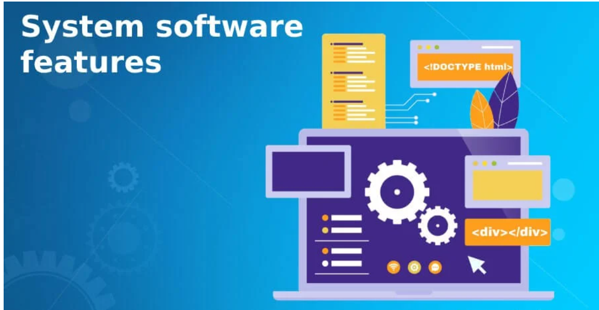
System Features
Key Features
Program Management: Create and list programs (TB, HIV, Malaria etc.).
Client Registration: Add clients to the system.
Enrollment: Assign clients to one or multiple programs
Search Clients: Find clients easily by name.
Client Profiles: View client details and enrollment history.
REST API Access: External systems can retrieve client data.

Slide 6
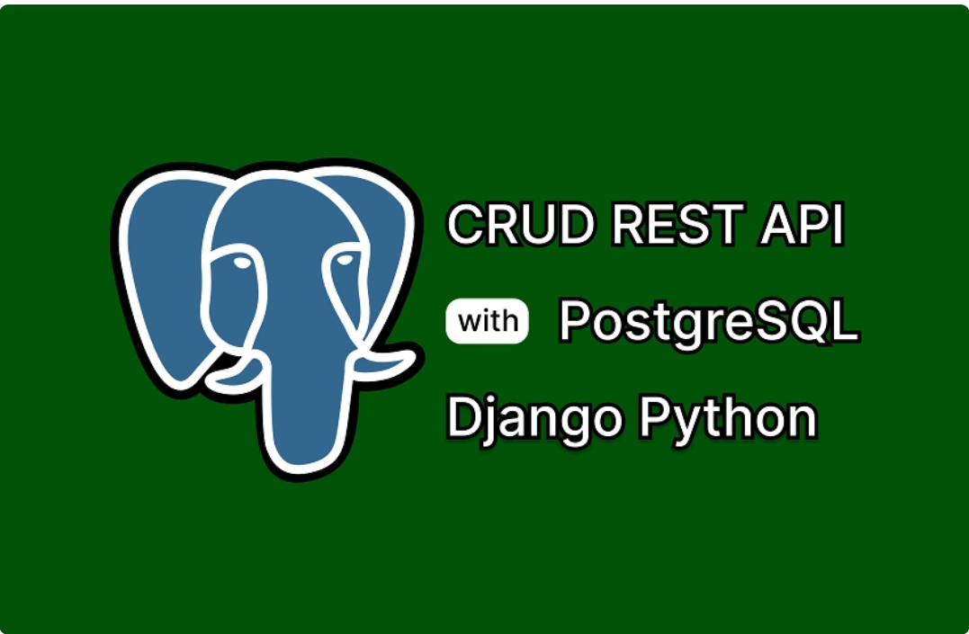
Technologies Used
Technologies
Backend: Django (Python): Django is a Python-based web framework that helps build secure and fast web applications.
API Framework: Django REST Framework (DRF): DRF makes it easy to build APIs in Django, allowing external apps to communicate with the system.
Authentication: JWT Tokens (SimpleJWT): JWT tokens securely verify users, ensuring only authorized doctors can access the system.
Database: PostgreSQL PostgreSQL is a reliable database for storing and managing client and program data.
Environment Management: python-dotenv python-dotenv helps securely manage environment variables like database credentials.

Slide 7
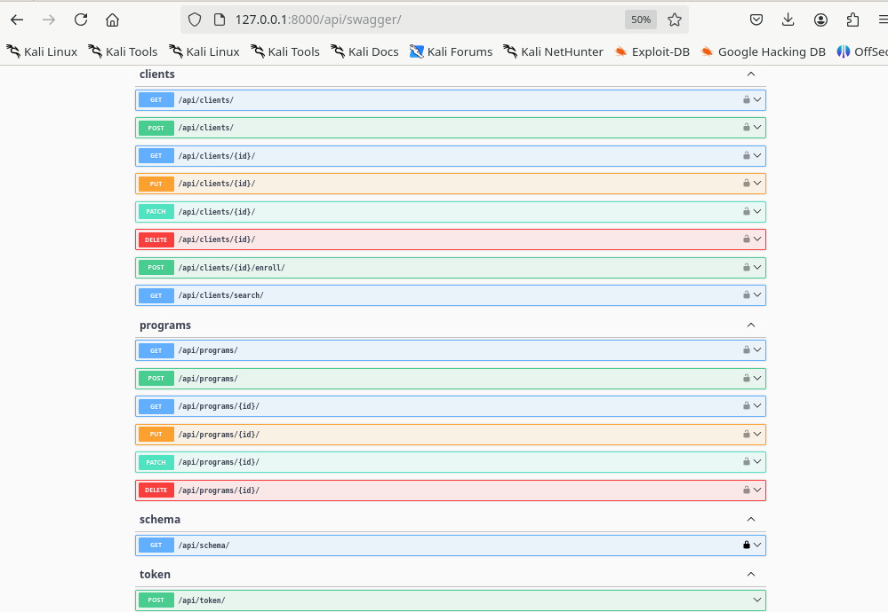
Core API Endpoints
API Endpoints
Post /api/programs/: Create Health Program.
POST /api/clients/ : Register Client
POST /api/clients/{id}/enroll/ : Enroll Client in Programs.
GET /api/clients/search/?name=... : Search Client.
GET /api/clients/{id}/: View Client Profile.

Slide 8
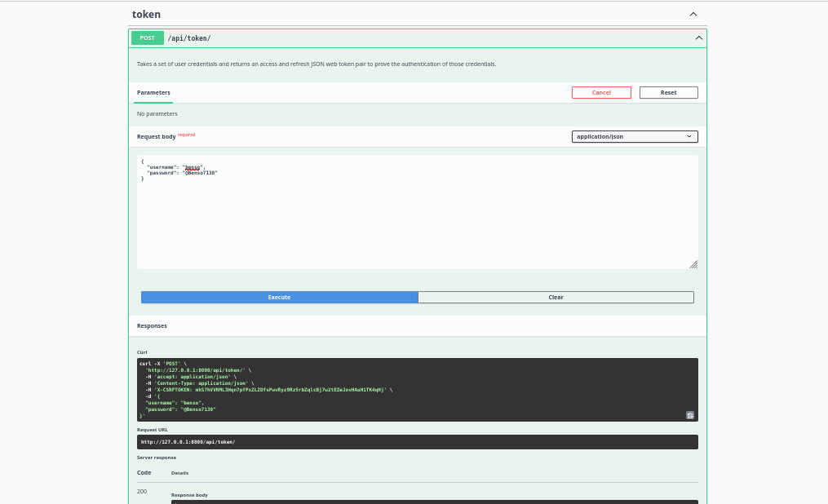
Security FEATURES
Security Features
JWT Authentication to protect APIs.
All API endpoints are protected using JSON Web Tokens (JWT) to ensure only verified users (doctors) can access the system.
Secure login generates access and refresh tokens, preventing unauthorized access.
Access Control:
Only authenticated users can:
Register new clients into the system
Enroll clients into health programs.
View or update sensitive client profiles.
Data Privacy:
Sensitive client data (personal information, enrollment status) is never exposed without authentication.

Slide 9
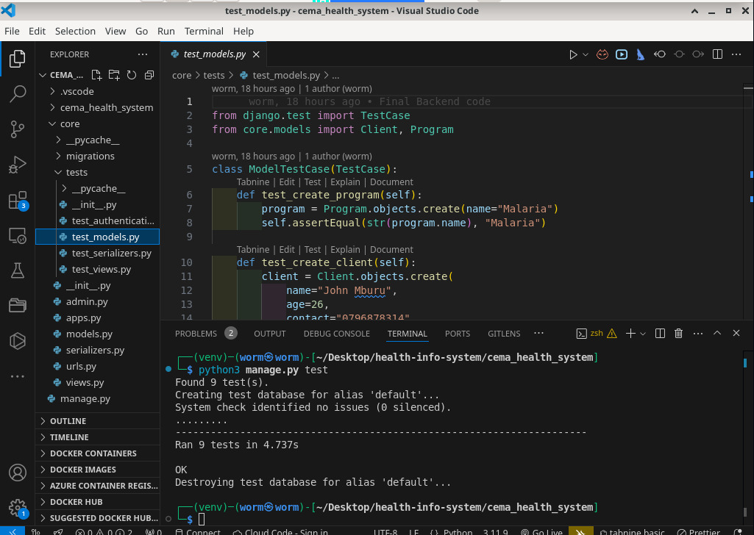
Testing
Testing
Postman API Testing:
All API endpoints were manually tested using Postman to verify correct functionality, authentication, and error handling.
Tests included creating health programs, registering clients, enrolling clients, and viewing profiles.
Automated Unit Tests:
Unit tests were written for:
Models: Ensuring data integrity for Clients and Programs.
Views: Confirming correct behavior of APIs (e.g., register, enroll, search).
Authentication: Making sure only authenticated users can access protected endpoints.
Django's APITestCase:
Used for creating automated API tests within Django.
Simulates real-world API calls to validate system behavior and security.

Slide 10
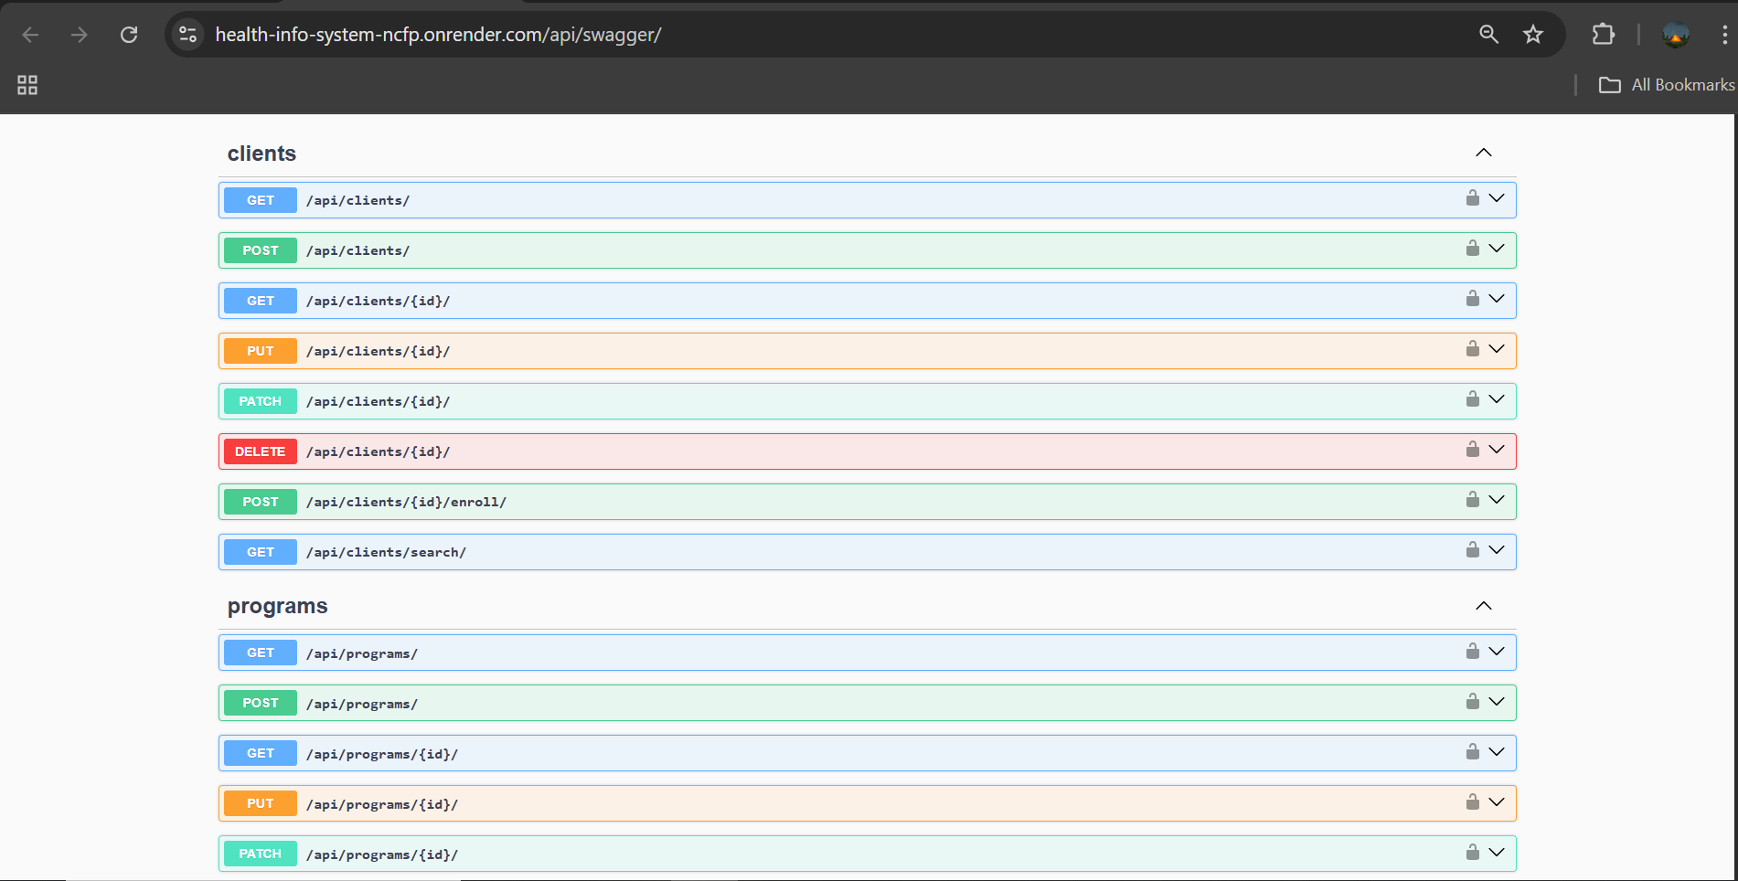
Deployment Steps
Setup & Deployment Steps
The application has been successfully deployed to Render. Users can now interact with the API through the Swagger interface.
To explore the application and its API endpoints, visit the following URL:
https://health-info-system-ncfp.onrender.com/api/swagger/
This link provides a user-friendly interface for making requests to the API and understanding the available endpoints.

Slide 11
Conclusion
Built a Secure and Scalable Health Information System: The system ensures data security through JWT authentication and is designed to scale as the number of clients or health programs increases.
Solves the Problem of Managing Clients and Health Program Enrollments: The application digitizes processes like client registration, program enrollment, and profile management, eliminating the inefficiencies of paper-based or manual systems.
APIs Ready for Integration: The system exposes all key functionalities via secure RESTful APIs, enabling seamless integration with other healthcare systems, mobile applications, or external services.

Slide 12
GitHub Repository
GitHub Link: https://github.com/benson1000/health-info-system

Slide 13



THANK YOU
BENSON KIMANI NGIGI
+254 729 281 651
bensonkimani1000@gmail.com

